Slide 1

Exploratory Data Analysis
Data Analysis for Cab Investment
By: Ihab Ahmed
Date: 20.06.2022

Slide 2
Agenda
Introduction
Data Used
Hypothesis
EDA
EDA Summary
Recommendations

Slide 3
Agenda
Introduction

Slide 4
Introduction
In this project, the company “XYZ” which is a private firm that is planning for an investment in Cab Industry and is taking G2M(Go-to-Market) strategy to understand the market before taking the final decision.
There are two rising cab companies to choose from:
Yellow Cab Company, and,
Pink Cab Company.
In this presentation, we are going to explore the two companies using the data provided and analyse their behaviour in the span of nearly three years to make sense of which company is worth investing in.

Slide 5
Agenda
Data Used

Slide 6
Data Used.
The following datasets is used in the analysis:
“Cab_Data”: Which has the details of transaction of the two cab companies, cities, date of travel, KM travelled, Cost of each trip and price charged for each trip.
“Customer_ID”: Mapping table that contains a unique identifier which links the customer’s demographic details.
“Transaction_ID”: Mapping table that contains transaction to customer mapping and payment mode.
“City”: contains list of US cities, their population and number of cab users.
“US Bank holidays”: Contain all official holidays.

Slide 7
Agenda
Hypothesis

Slide 8
Hypothesis
Hypothesis and Questions:
1- Which company has maximum cab users at a particular time period ?
2- Does margin proportionally increase with increase in number of customers ?
3- What cities where people use cab the most? In these cities which cab company is most demanded ?
4- In public holidays which company is the most demanded ?
Business problem:
- Go to market strategy (G2M), investigate two cab companies activities before investment.

Slide 9
Agenda
EDA

Slide 10
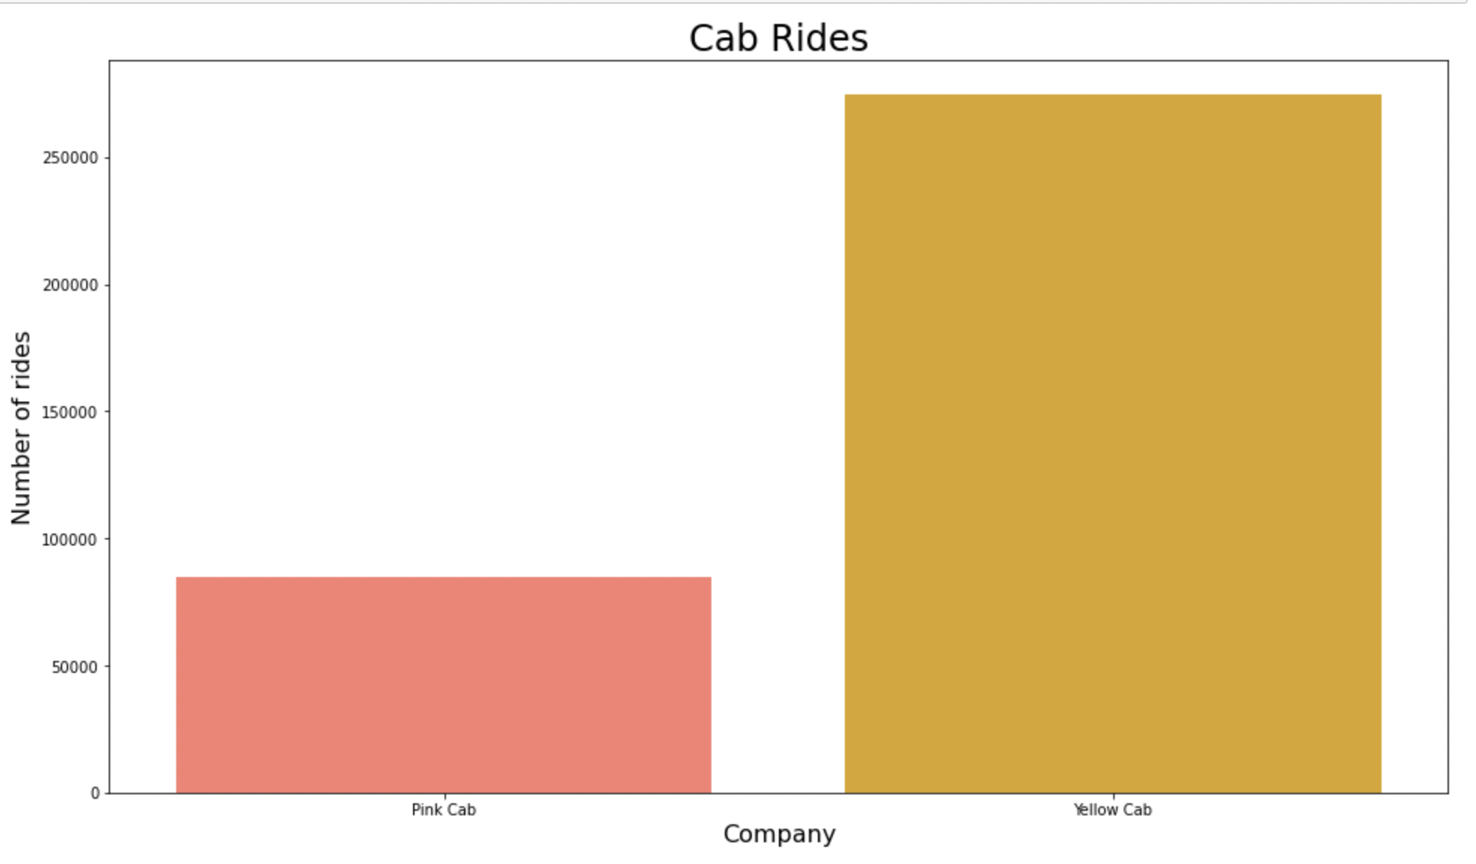
Exploratory Data Analysis: Cab Rides
Number of Pink Cab rides vs Yellow Cab rides (in the span of three years):
Total Yellow Cab rides (approx): 280000.
Total Pink Cab rides (approx): 85000
As notices yellow cab rides is more than thrice the pink cab rides

Slide 11
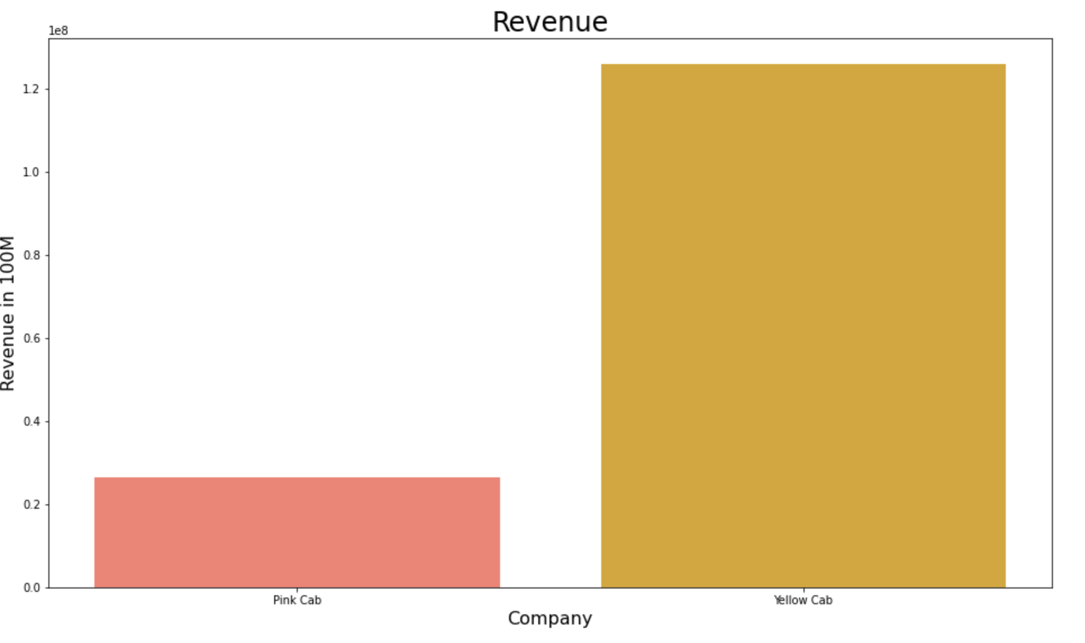
Exploratory Data Analysis: Revenue
Revenue of Pink Cab vs Yellow Cab (in the span of three years):
Yellow Cab total revenue (approx): 125M $.
Pink Cab total revenue (approx): 26M $.
Yellow Cab has nearly 5x the revenue of Pink Cab.

Slide 12
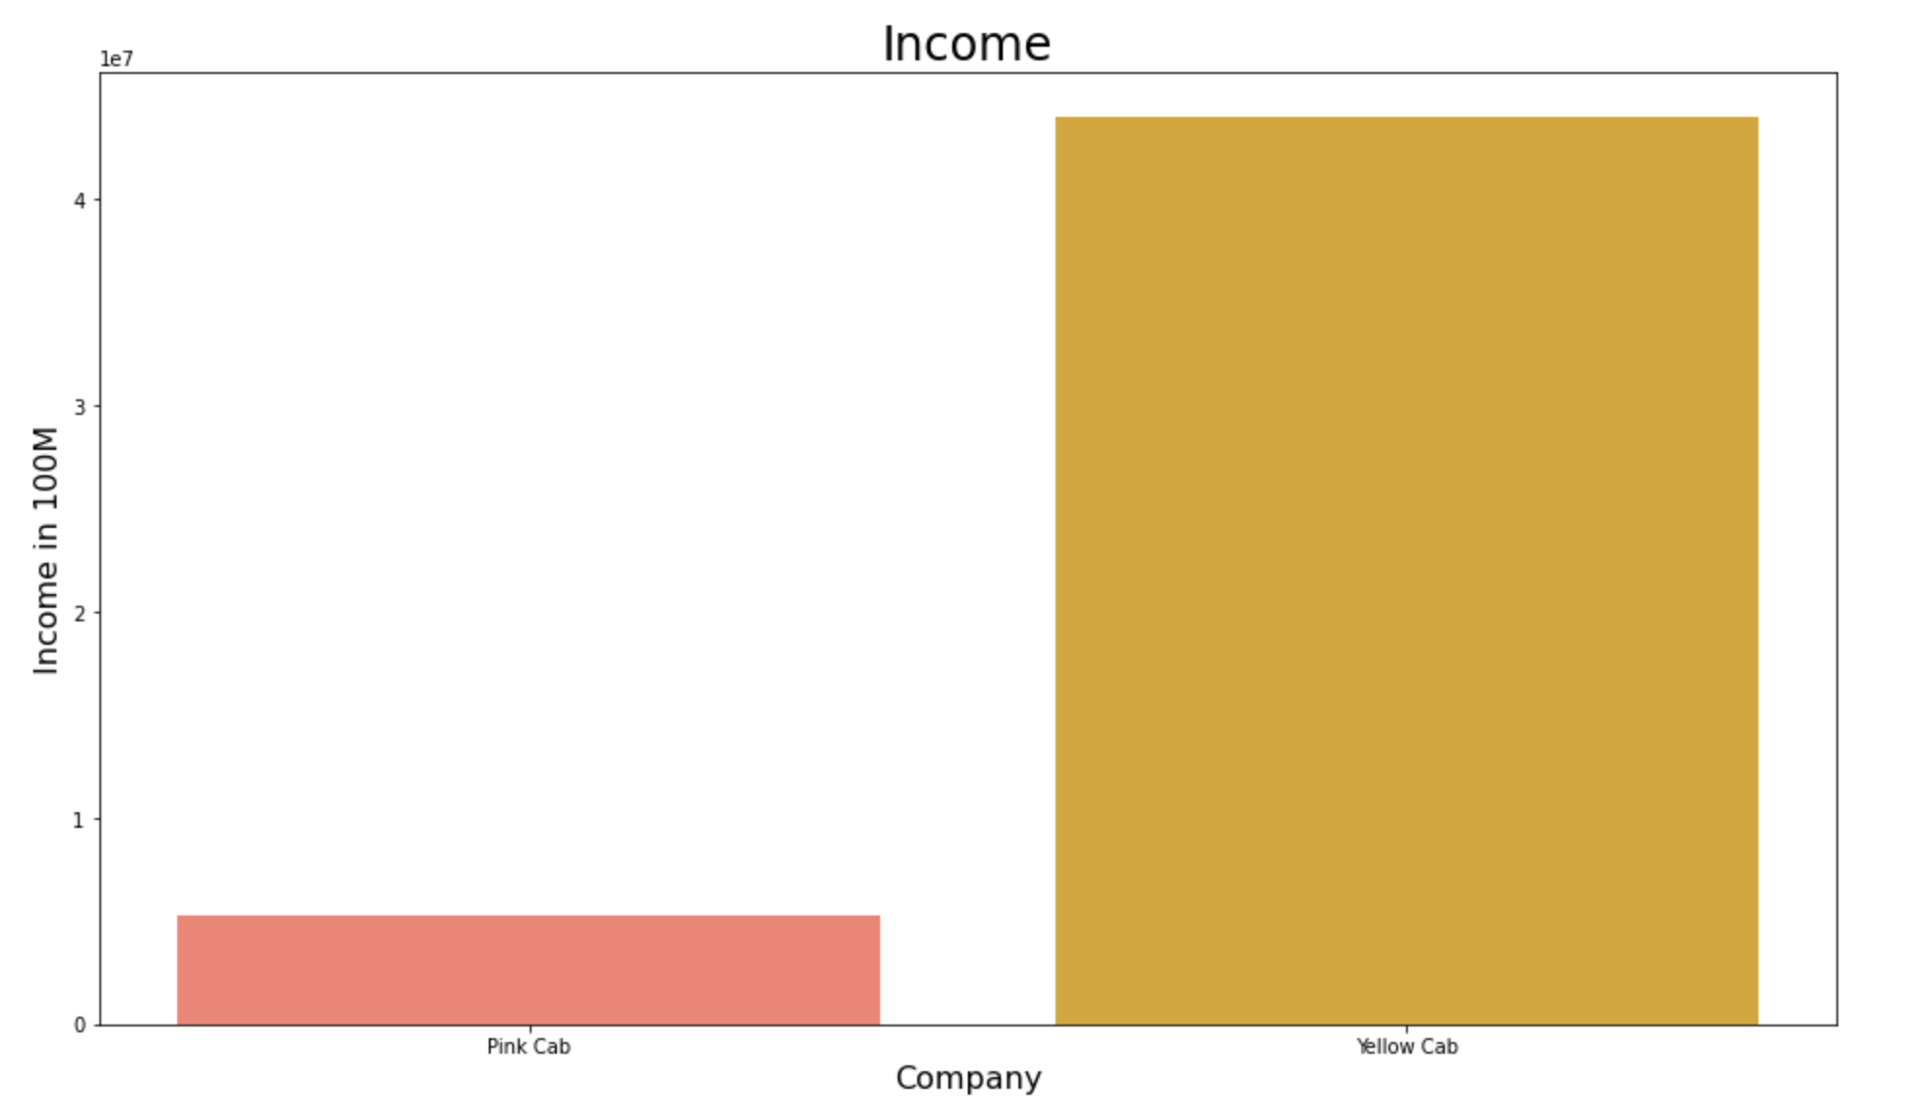
Exploratory Data Analysis: Income
Income of Pink Cab vs Yellow Cab (in the span of three years):
Yellow Cab total Income (approx): 44M $.
Pink Cab total Income (approx): 5.3M $.
Yellow Cab’s income is more than 8x Pink Cab’s Income.

Slide 13
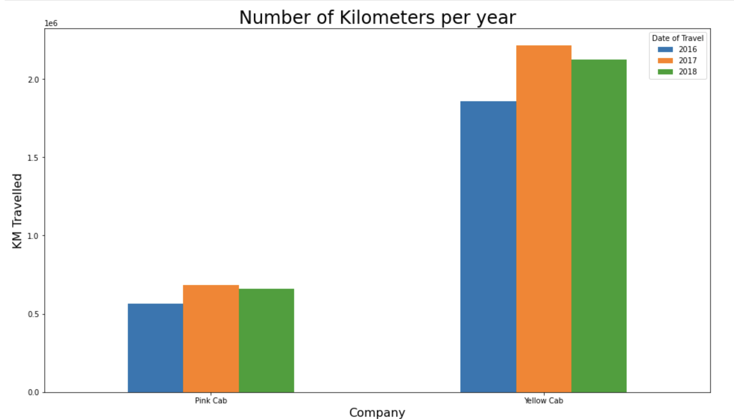
Exploratory Data Analysis: Yearwise
Total activity of each cab company in each year (2016, 2017, 2018)
Kilometers Travelled:
Yellow Cab (2016): 1.8M Km.
Pink Cab (2016): 560K km.
Yellow Cab (2017): 2.2M Km.
Pink Cab (2017): 680K Km.
Yellow Cab (2018): 2.1M Km.
Pink Cab (2018): 661K Km.
In every year Yellow Cab travel 3x more than Pink Cabs

Slide 14
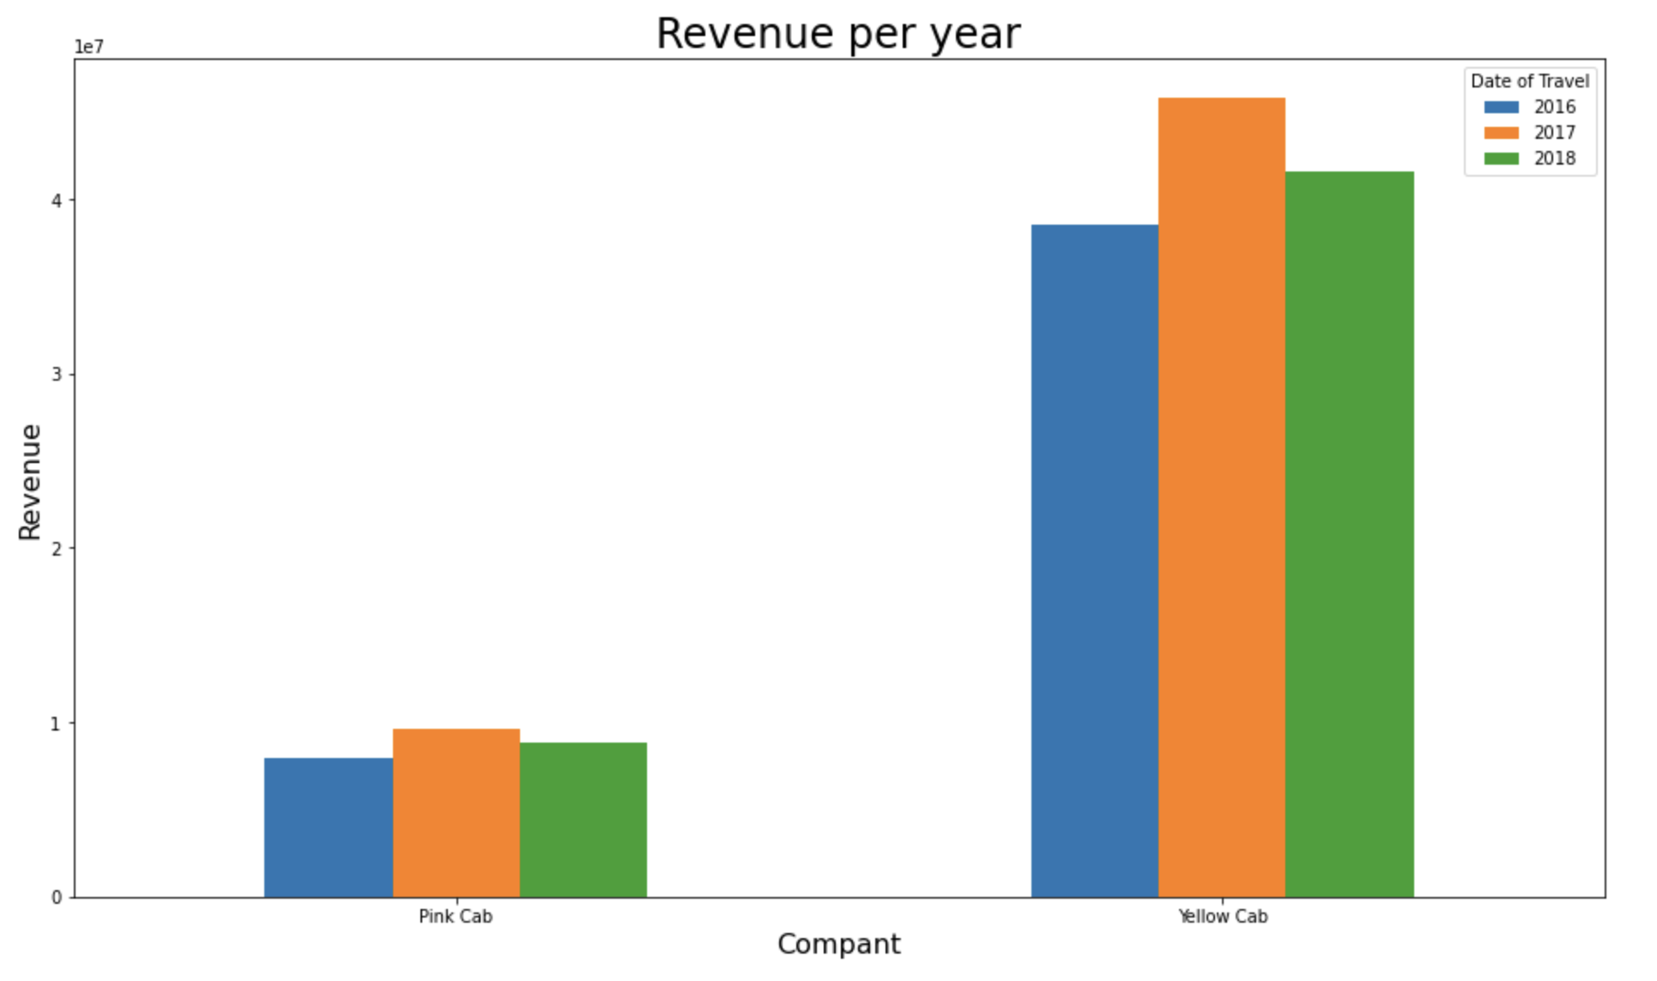
Exploratory Data Analysis: Yearwise
Total Revenue of each cab company in each year (2016, 2017, 2018)
Kilometers Travelled:
Yellow Cab (2016): 38M $.
Pink Cab (2016): 7.9M $.
Yellow Cab (2017): 45M $.
Pink Cab (2017): 9.5M $.
Yellow Cab (2018): 41M $.
Pink Cab (2018): 8.8M $.
In every year Yellow Cab has approx. 5x more revenue than Pink Cab

Slide 15
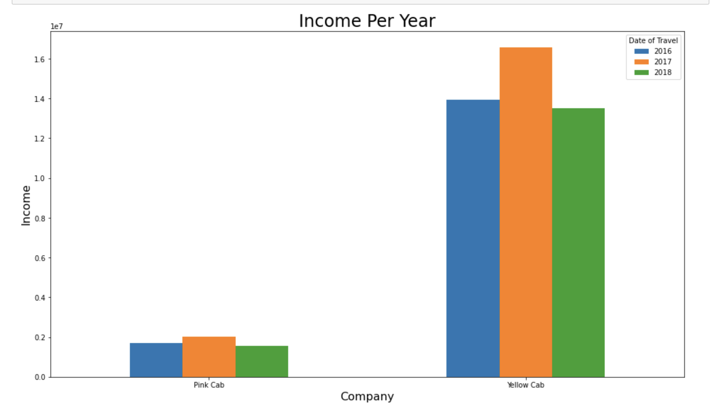
Exploratory Data Analysis: Yearwise
Total Income of each cab company in each year (2016, 2017, 2018)
Kilometers Travelled:
Yellow Cab (2016): 13M $.
Pink Cab (2016): 1.7M $.
Yellow Cab (2017): 16M $.
Pink Cab (2017): 2M $.
Yellow Cab (2018): 13M $.
Pink Cab (2018): 1.5M $.
In every year Yellow Cab has approx. 8x more profit than Pink Cab.

Slide 16
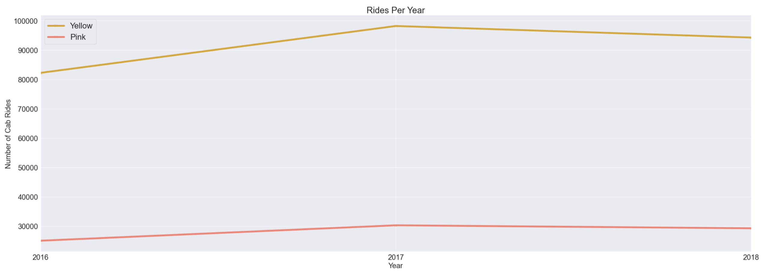
Exploratory Data Analysis: Yearwise
Q1- Which company has maximum cab users at a particular time period ?

Slide 17
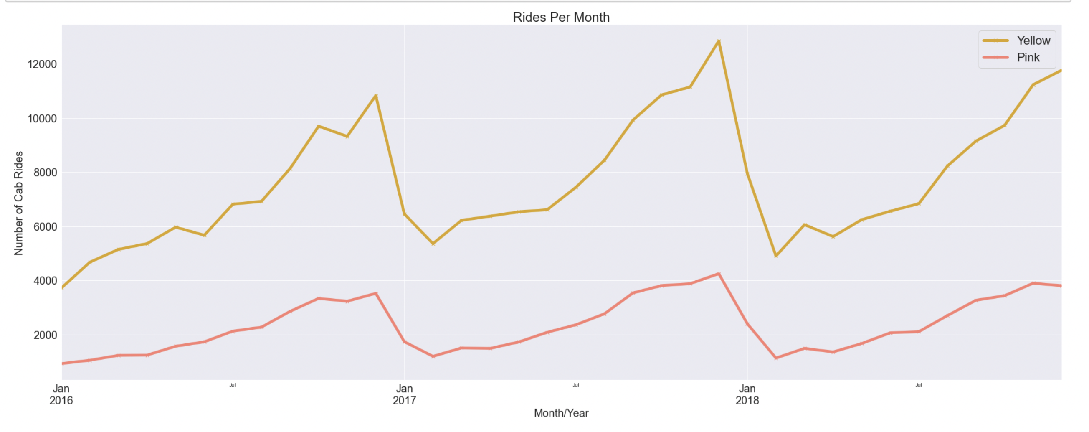
Exploratory Data Analysis: Monthwise
Q1- Which company has maximum cab users at a particular time period ?

Slide 18
Hypothesis 1 answer
Q1- Which company has maximum cab users at a particular time period ?
Ans1- Yellow Cab company has much more cab users Yearly and monthly from 2016 to 2019

Slide 19
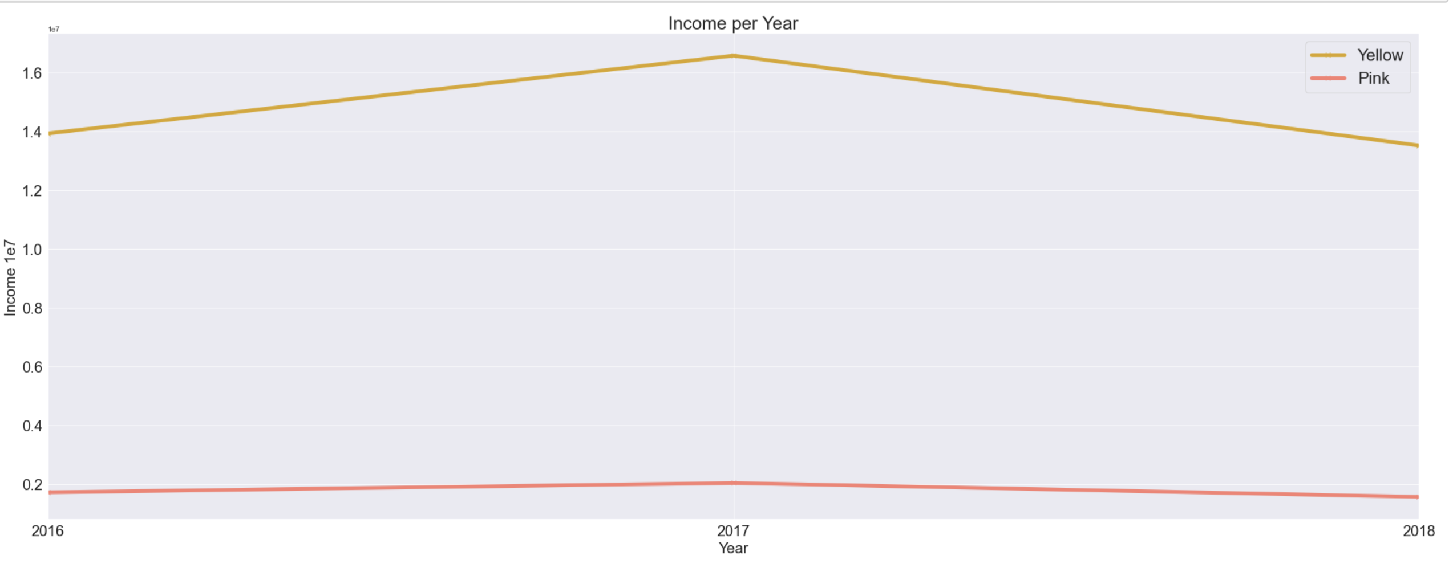
Exploratory Data Analysis: Yearwise
Q2- Does margin increase with increase in number of customers ?

Slide 20
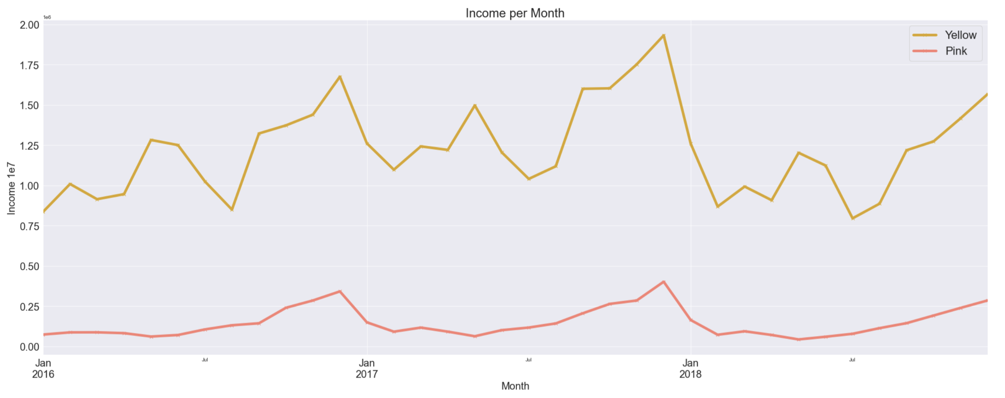
Exploratory Data Analysis: Monthwise
Q2- Does margin increase with increase in number of customers ?

Slide 21
Hypothesis 2 answer
Q2- Does margin proportionally increase with increase in number of customers ?
Ans2- Yes, Yellow cab company has much more income than pink cab company, since it has more customers

Slide 22
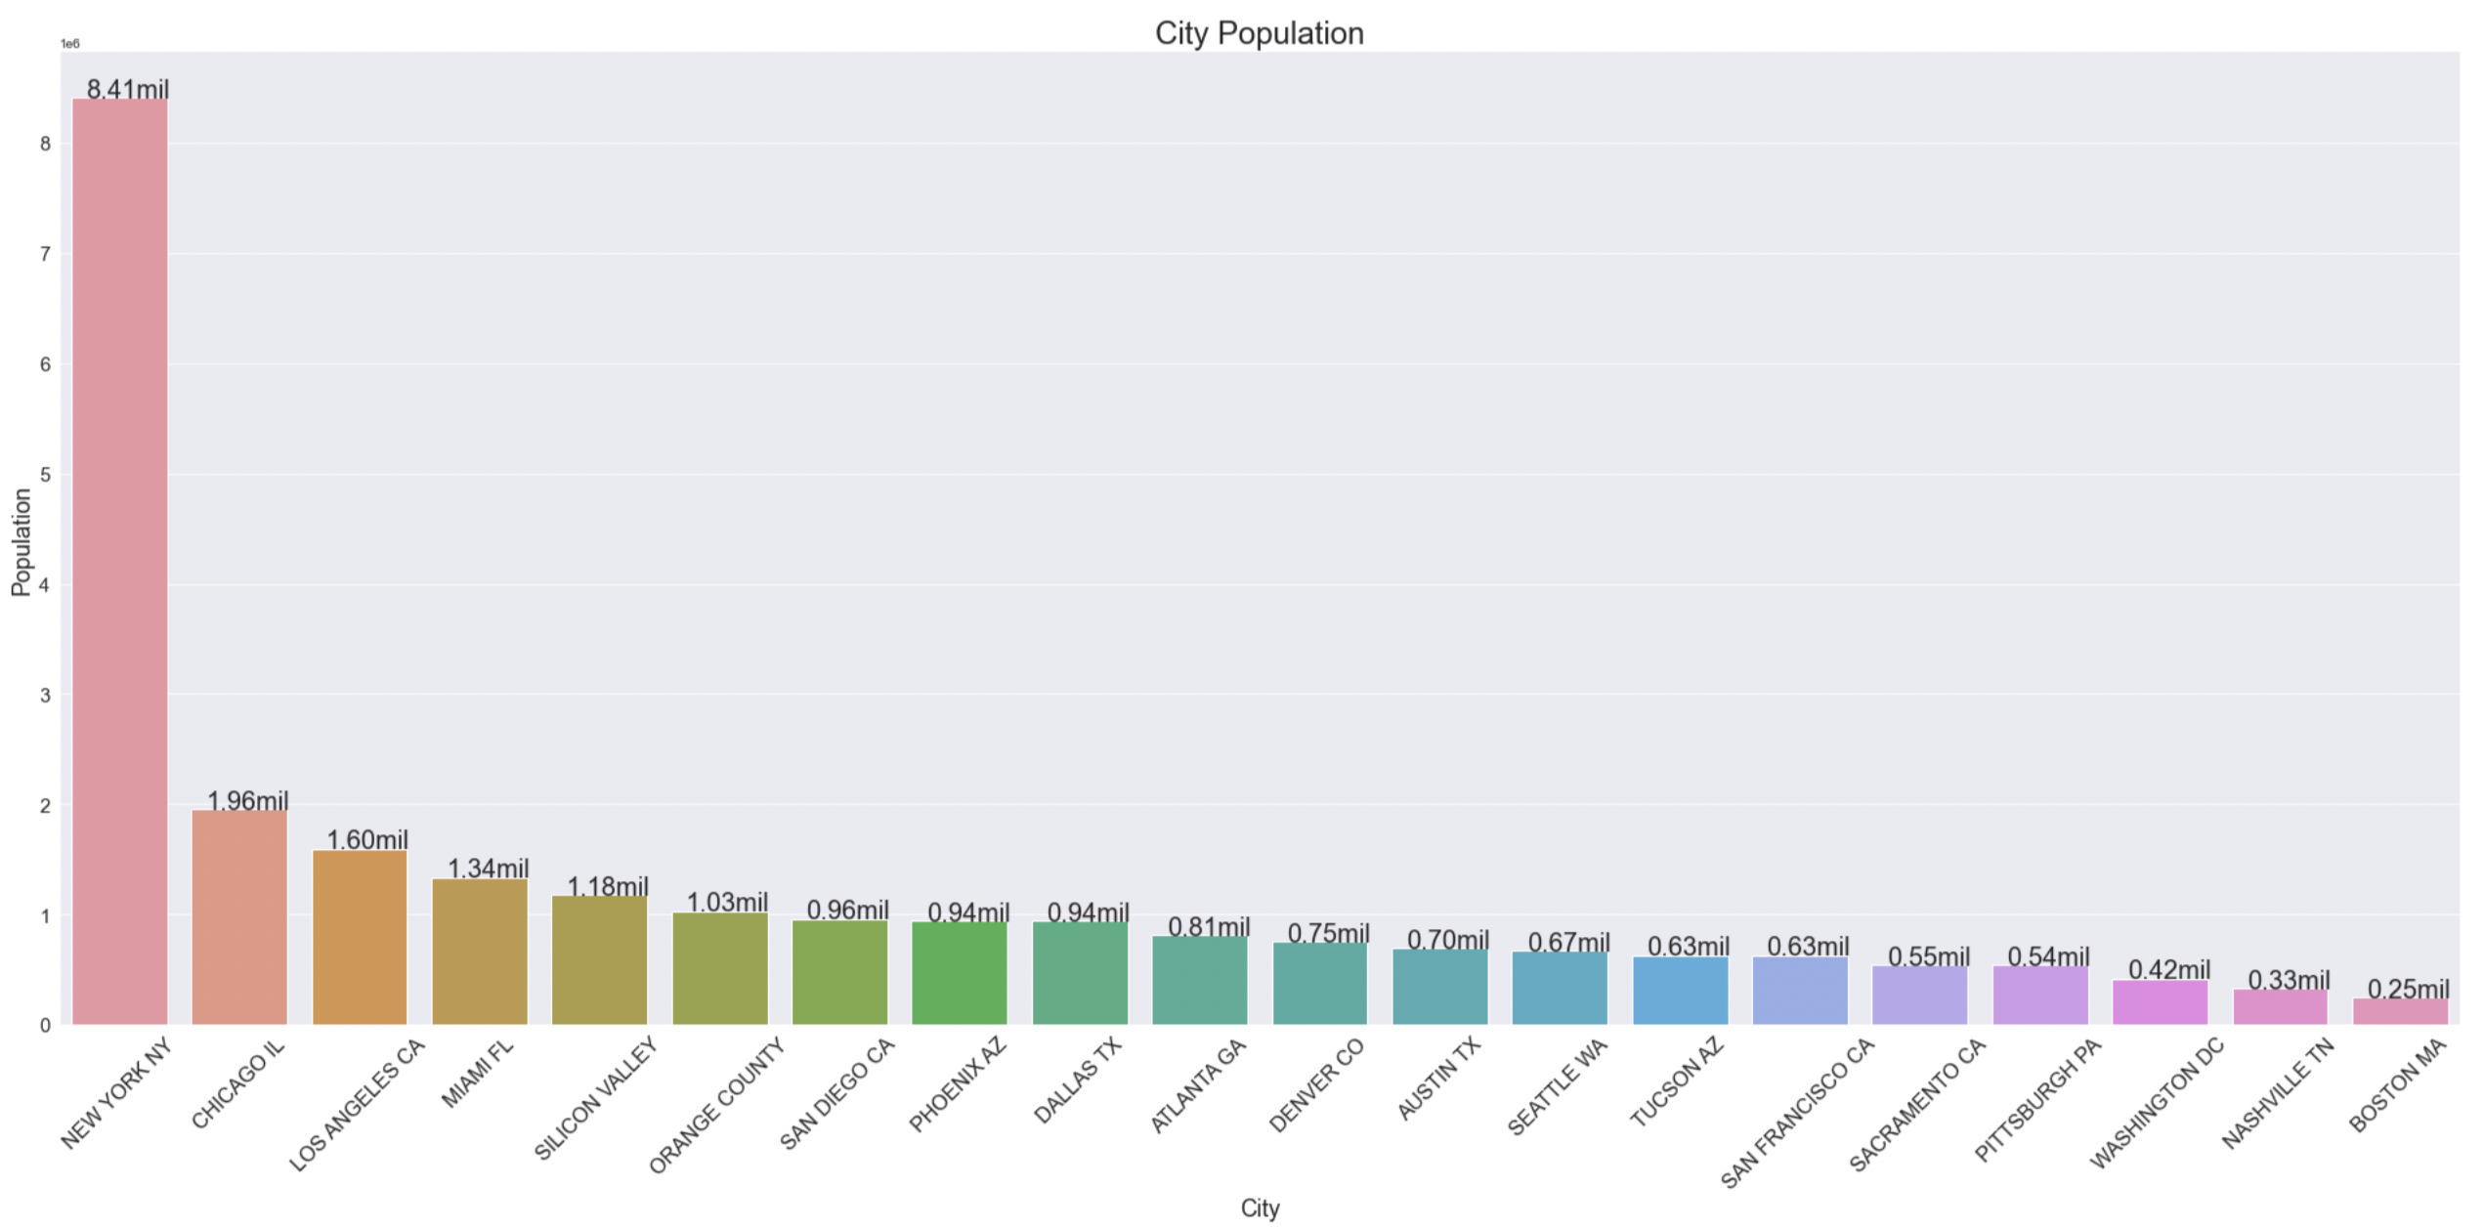
EDA: Cities, Cab Rides and Income
Population Distribution:

Slide 23
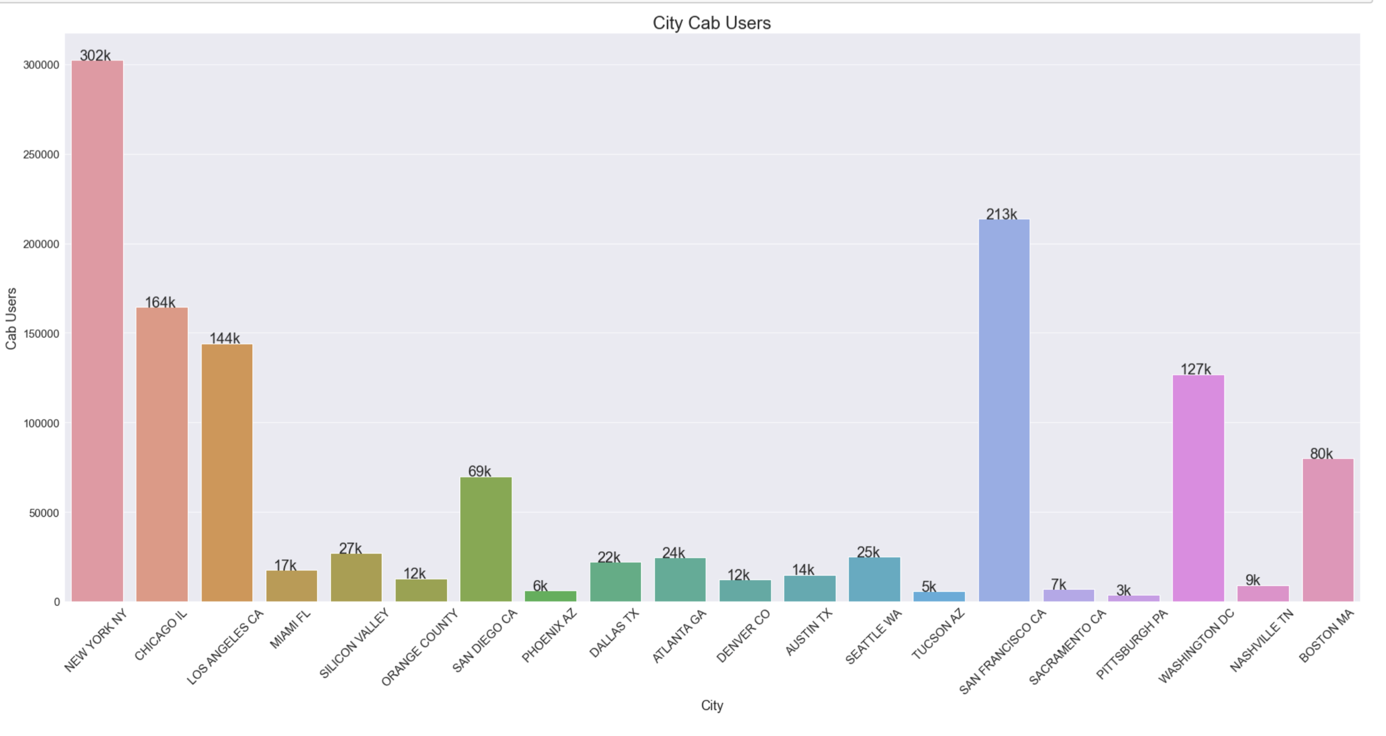
EDA: Cities, Cab Rides and Income
Cab User Distribution:

Slide 24
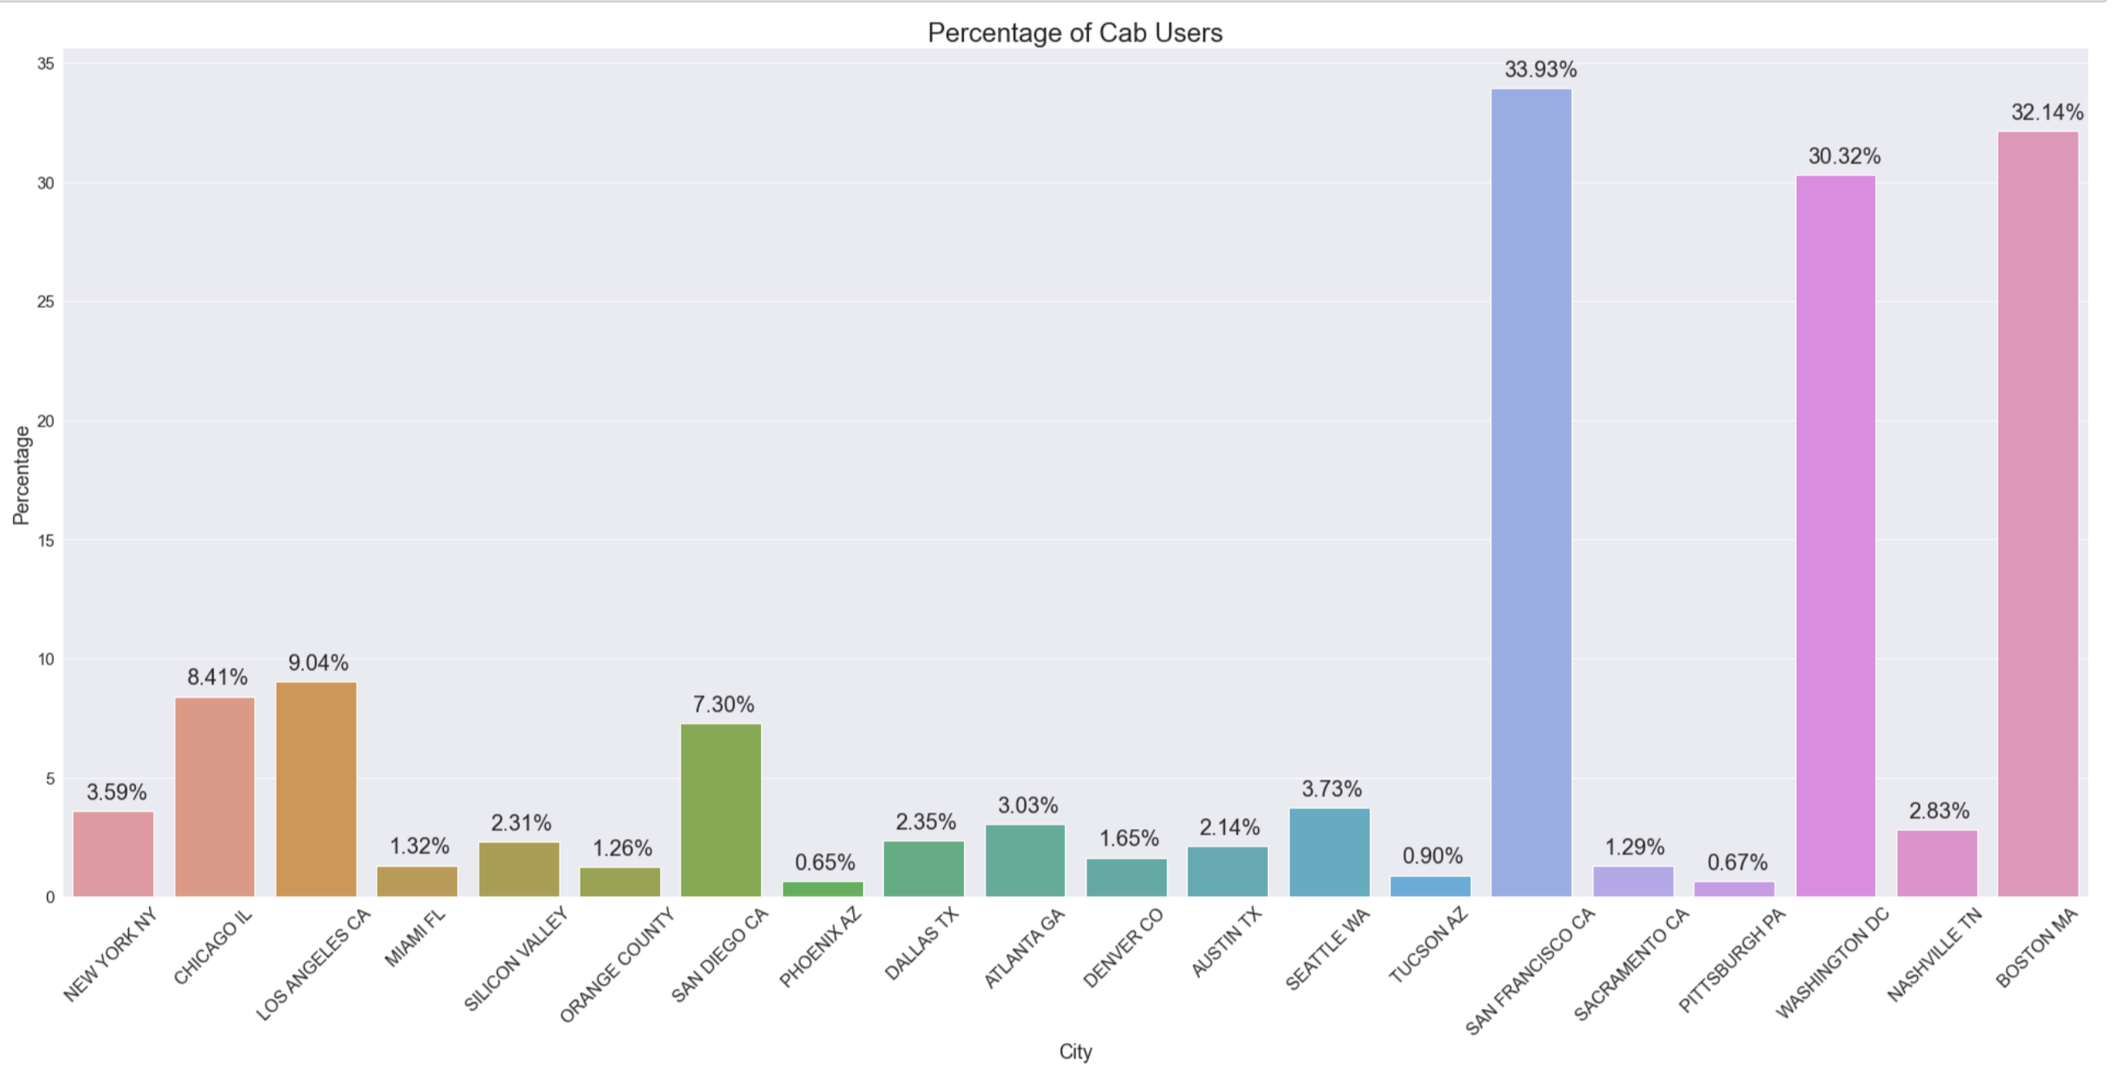
EDA: Cities, Cab Rides and Income
Percentage Distribution:

Slide 25
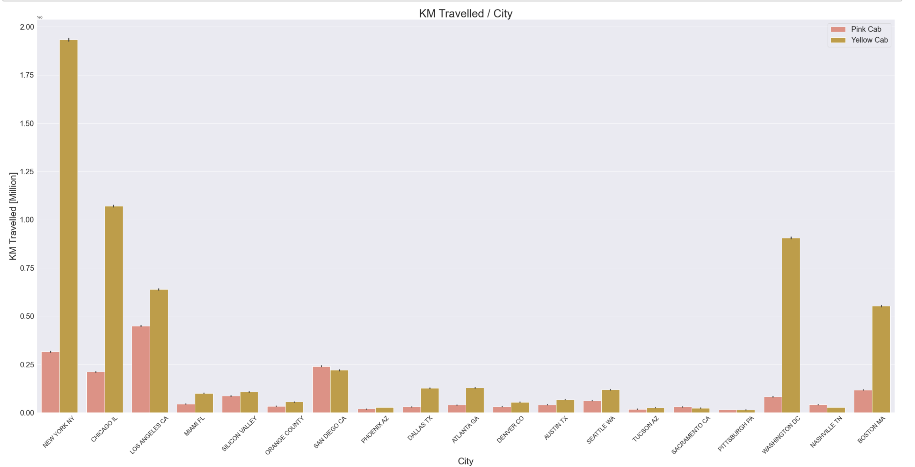
EDA: Cities, Cab Rides and Income
Profit and Activity of each cab company in each city:
- Yellow/Pink Cabs KM Travelled per city:

Slide 26
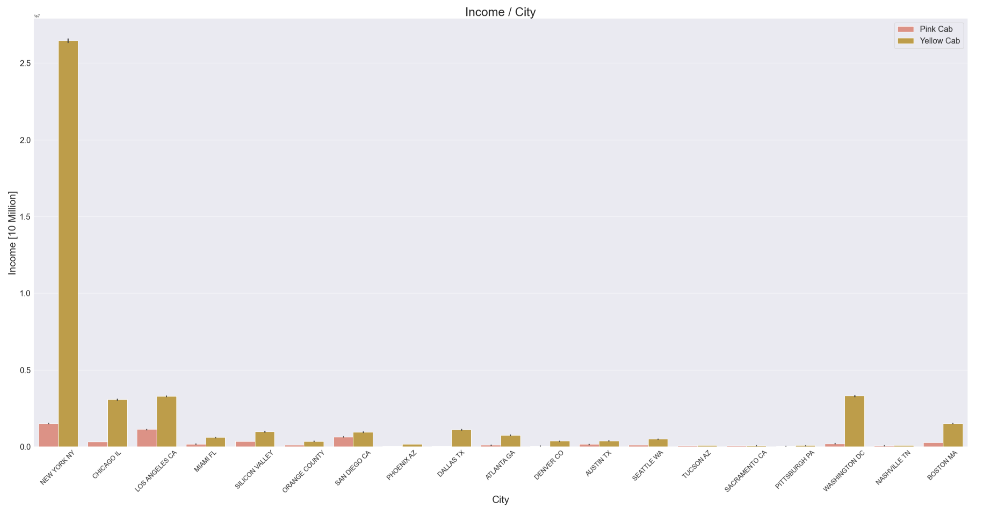
EDA: Cities, Cab Rides and Income
Profit and Activity of each cab company in each city:
- Yellow/Pink Cabs Income per city:

Slide 27
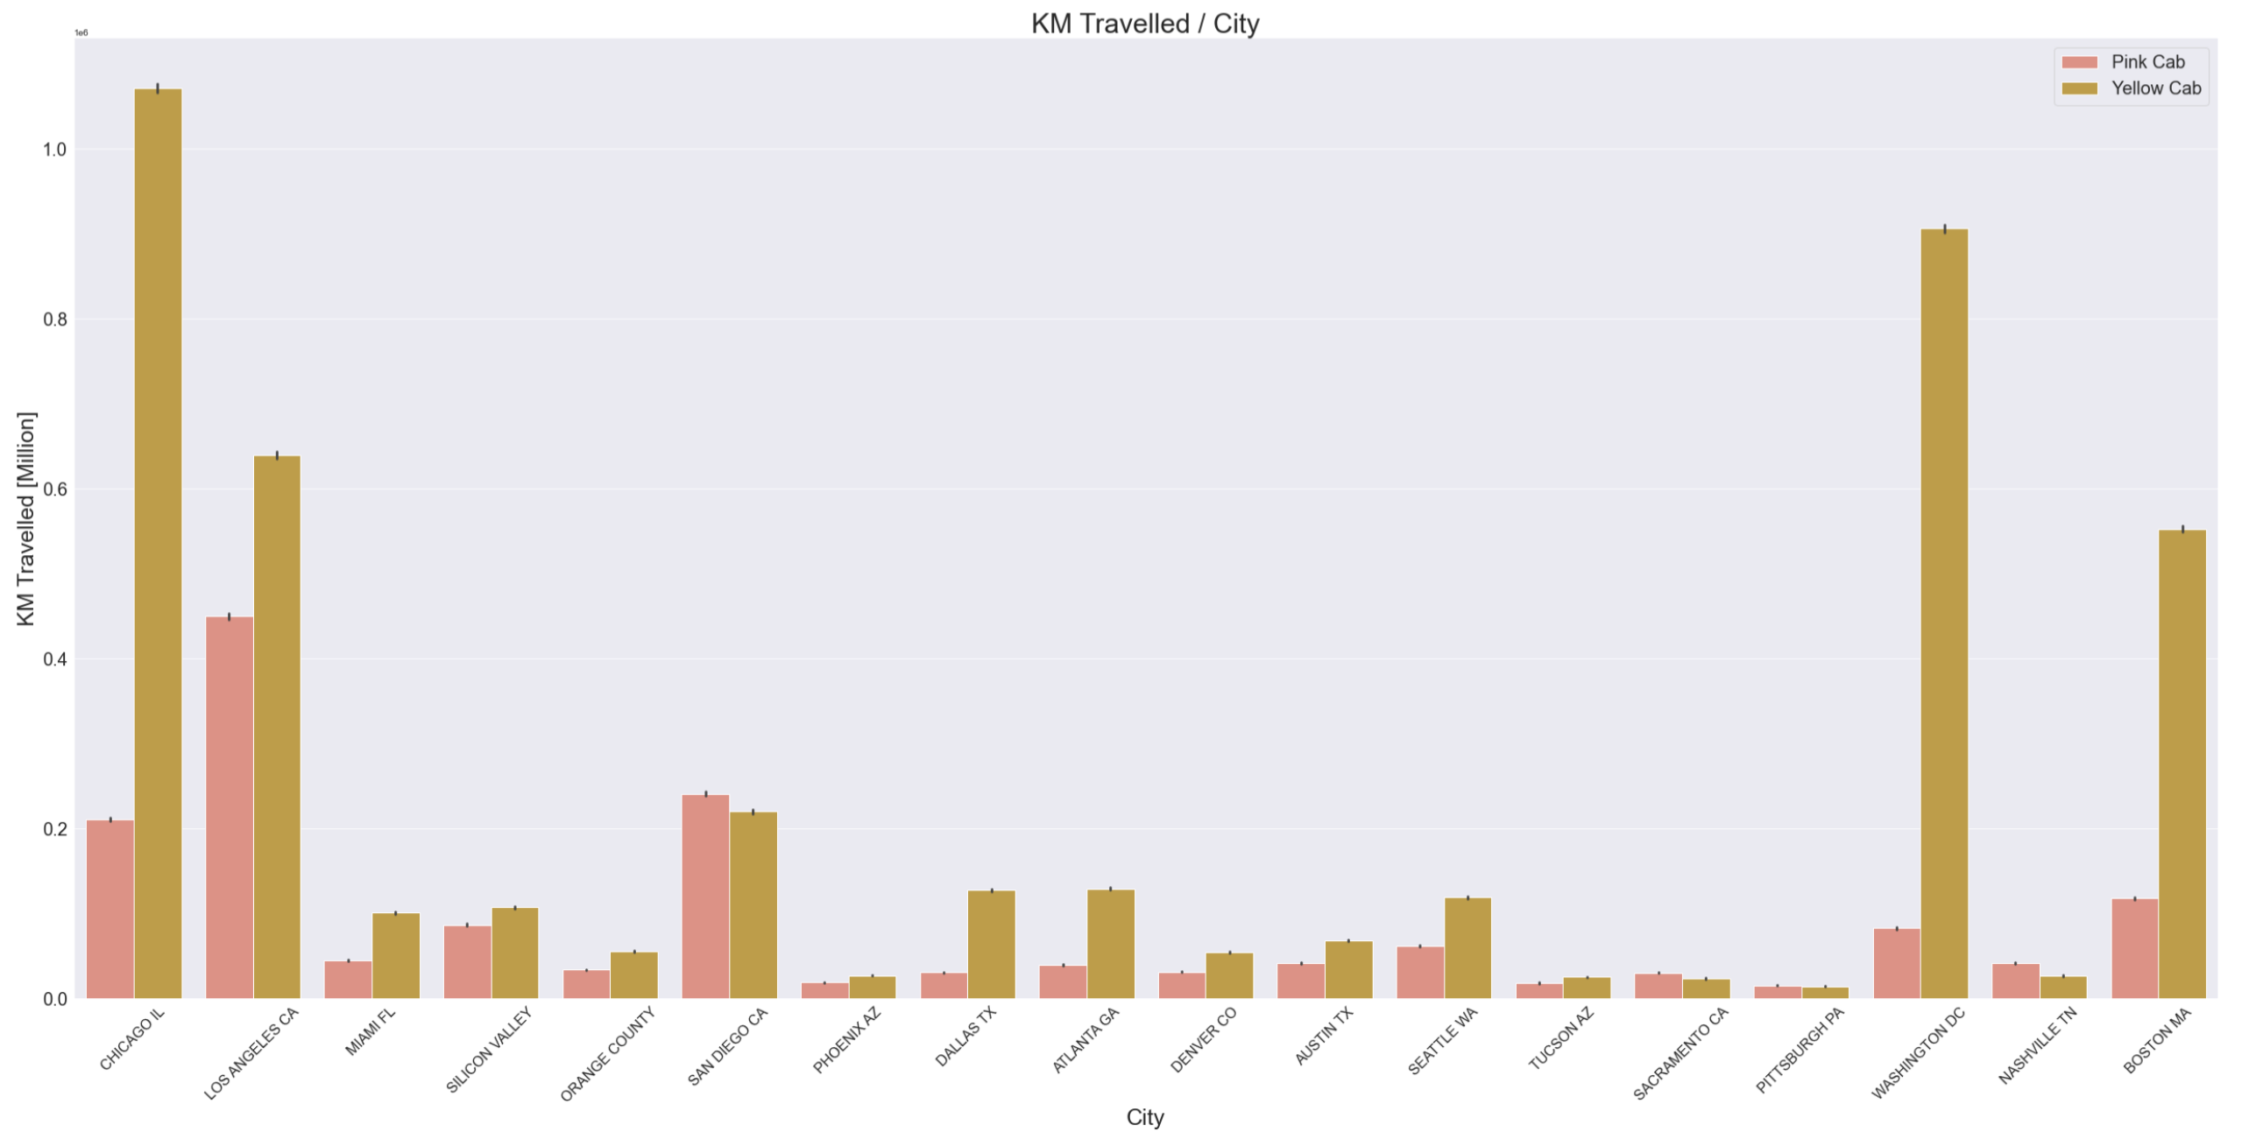
EDA: Cities, Cab Rides and Income
Profit and Activity of each cab company in each city:
- Yellow/Pink Cabs KM Travelled per city (without New York to make sense of other cities):

Slide 28
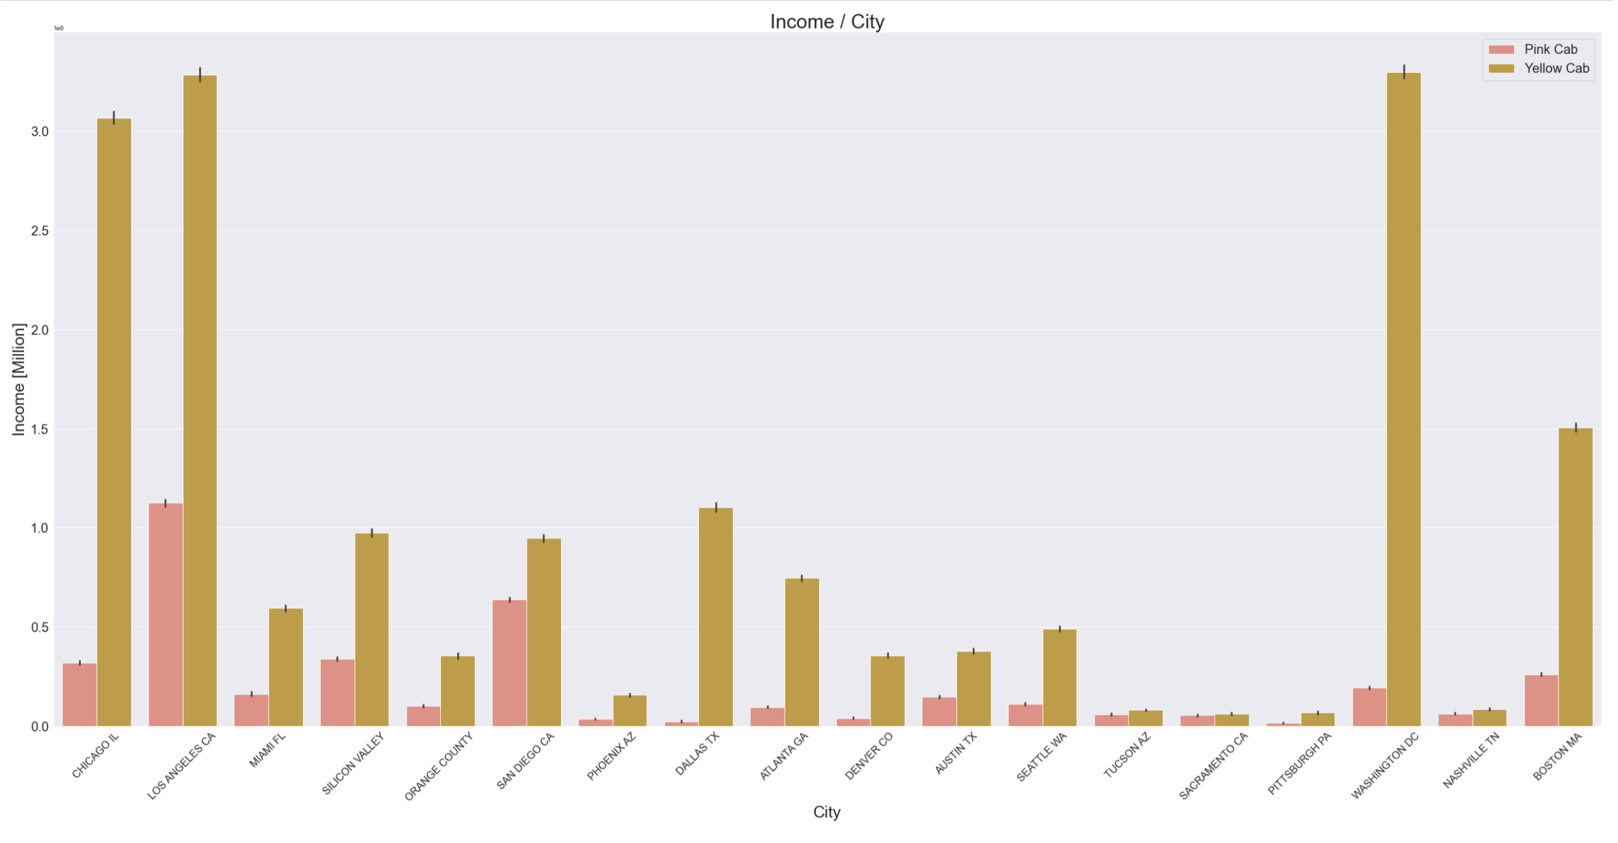
EDA: Cities, Cab Rides and Income
Profit and Activity of each cab company in each city:
- Yellow/Pink Cabs Income (without New York to make sense of other cities):

Slide 29
Hypothesis 3 answer
Q3- What cities where people use cab the most? In these cities which cab company is most demanded ?
Ans3- In almost every city, Yellow cab is much more demanded and profitable

Slide 30
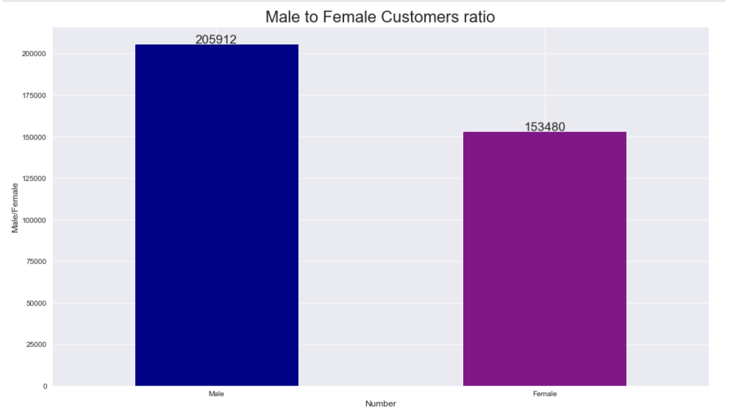
EDA: Male/Female Customers

Slide 31
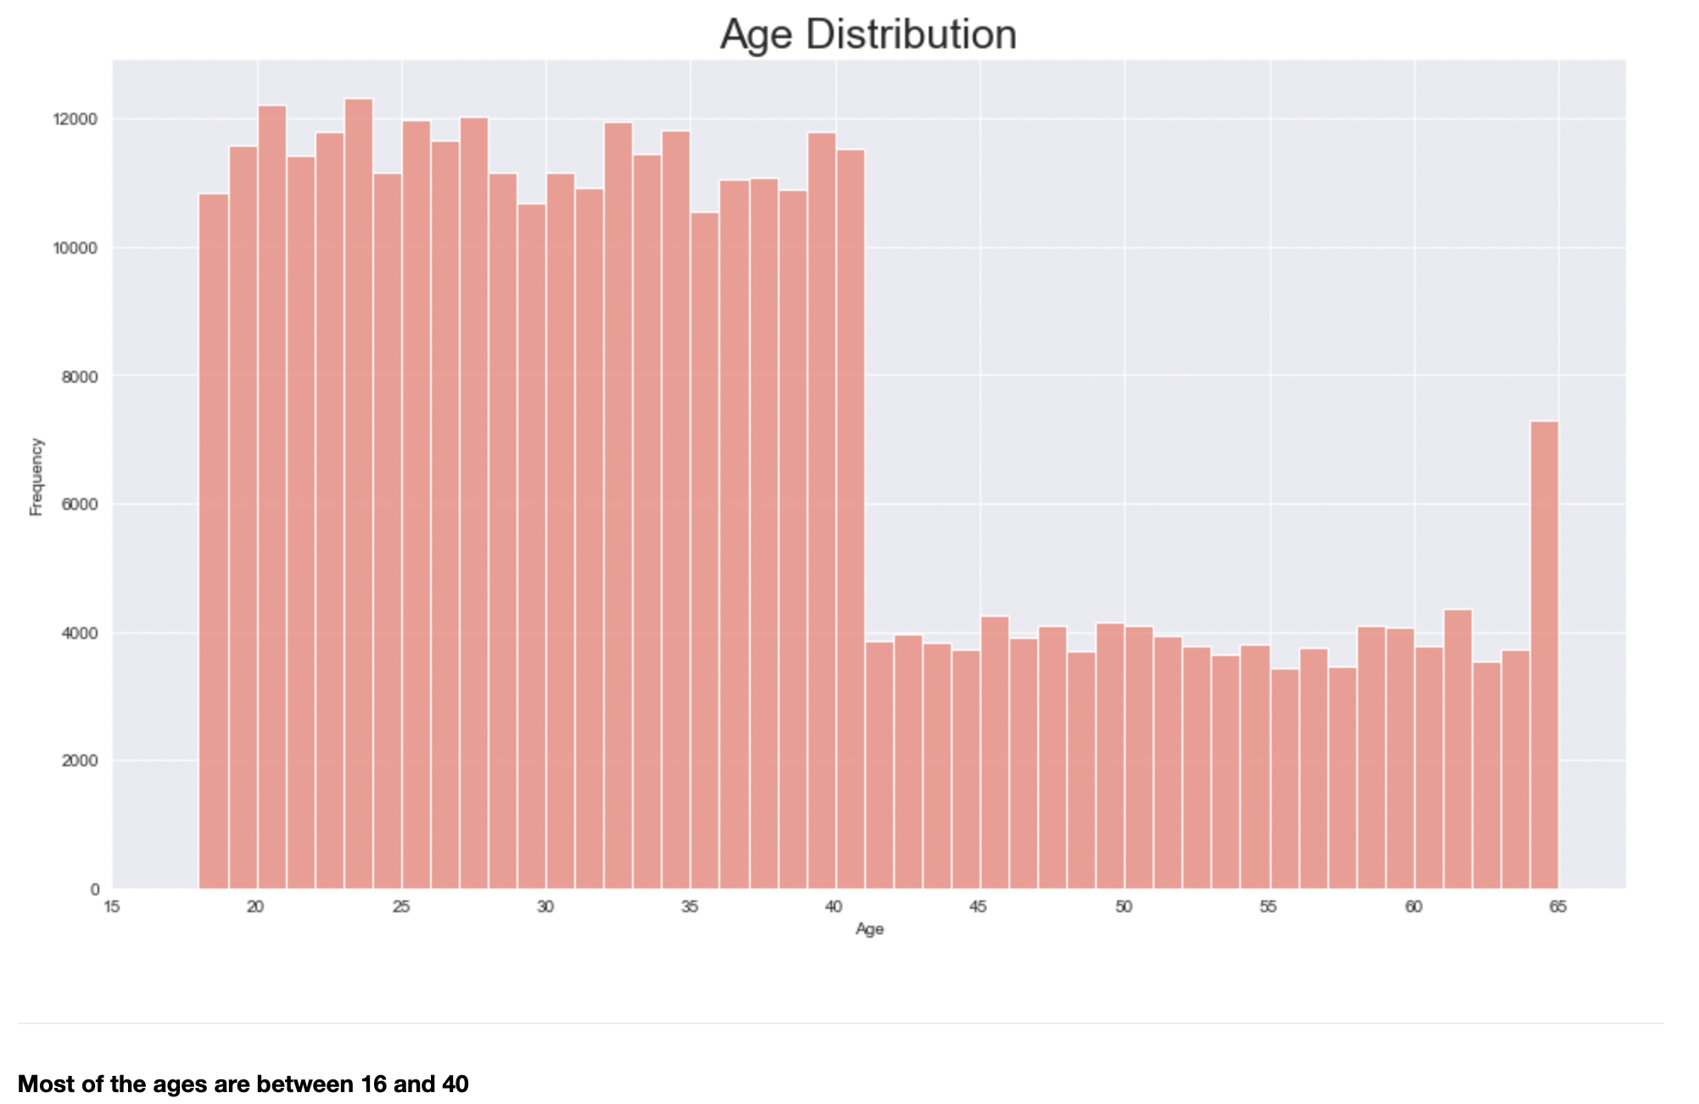
EDA: Age Distribution

Slide 32
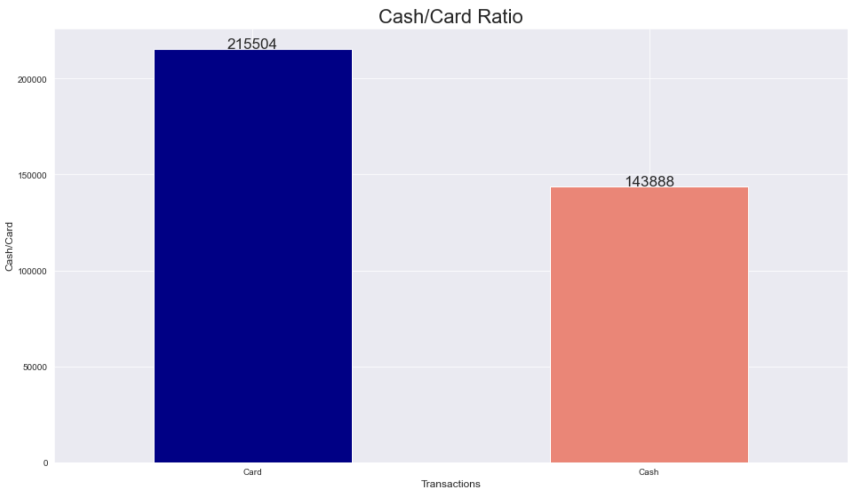
EDA: Cash/Card Payment

Slide 33
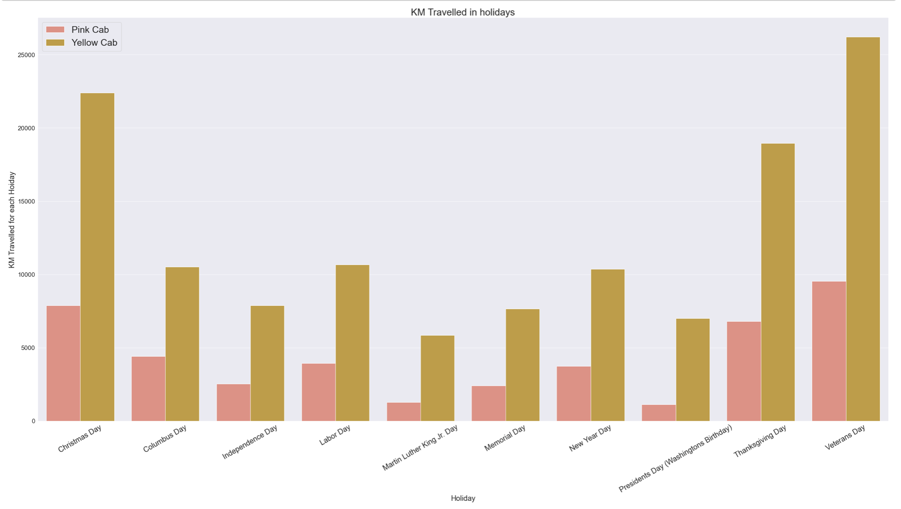
EDA: Holidays
Q4: In holidays which company is the most demanded ?
- In every holiday the activity of Yellow Cab is minimum 4x the activity of Pink Cab.

Slide 34
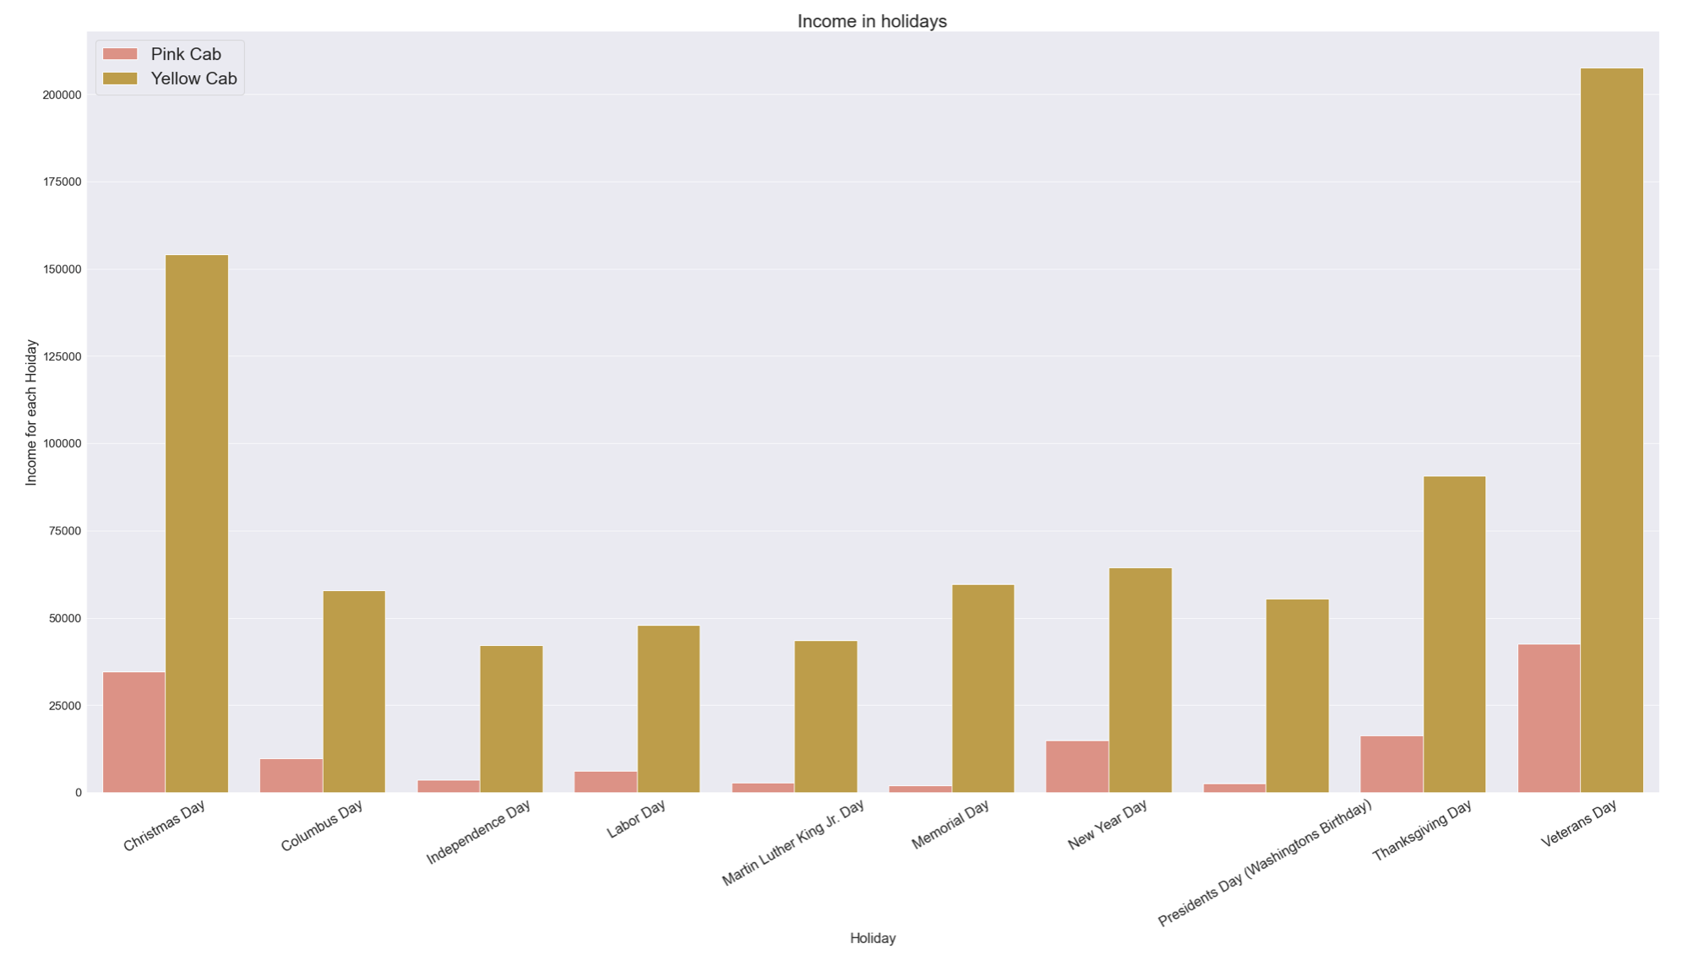
EDA: Holidays
Q4: In holidays which company is the most demanded ?
- In every holiday the Income of Yellow Cab is minimum 6x the Income of Pink Cab.

Slide 35
Hypothesis 4 answer
Q4: In holidays which company is the most demanded ?
Ans3- In every holiday, Yellow Cab is the most demanded and most Profitable

Slide 36
Agenda
EDA Summary.

Slide 37
EDA: Summary
Over the span of three years (2016, 2017, 2018):
Total Yellow Cab rides are more than thrice Pink Cab rides.
Total Yellow Cab revenue is 5x total Pink Cab revenue.
Total Yellow Cab Income is 8x total Pink Cab Income.
In every year Yellow Cab travel 3x more than Pink Cabs.
In every year Yellow Cab has approx. 5x more revenue than Pink Cab.
In every year Yellow Cab has approx. 8x more profit than Pink Cab.
In almost every city, Yellow cab is much more demanded and profitable.
In every public holiday, Yellow Cab is the most demanded and most Profitable.

Slide 38
Agenda
Conclusion

Slide 39
Conclusion
In Conclusion: Based on the investigation above, it is safe to say you should invest in the Company ‘Yellow Cab’.

Slide 40
Thank You

